Slide 1
AGENTIC AI STOCK PREDICTION SYSTEM
NSE & BSE | Technical + Fundamental + ML Ensemble | 12-Month Forecast
NITYASREE VANGALA

Slide 2
Problem statement
Design and build a Multi-Model Agentic AI Stock Analysis System that enables users to:
Search Indian listed companies (NSE & BSE) via an intelligent autocomplete search (Google-like experience).
Dynamically construct an autonomous AI agent that:
Performs fundamental analysis
Performs technical analysis
Synthesizes insights using an LLM reasoning layer
Generate:
Layman-friendly Top 5 Fundamental Indicators
Layman-friendly Top 5 Technical Indicators
12-month monthly stock price forecast
Actionable recommendation: Buy / Hold / Sell
Visualize predictions with stock-like charts
Operate only on real historical market data
Focus initially on Top 5 Indian companies
2 historically upward-trending
2 historically downward-trending
1–2 consolidation / hold-type stocks

Slide 3
Constraints & Assumptions
Markets considered: NSE & BSE
Base historical cutoff: Closing prices up to 31-12-2025
Predictions are probabilistic, not guaranteed
LLM is trained from scratch (domain-specific), not fine-tuned ChatGPT
System prioritizes explainability over blind accuracy
Predictions reflect real-world market uncertainty

Slide 4
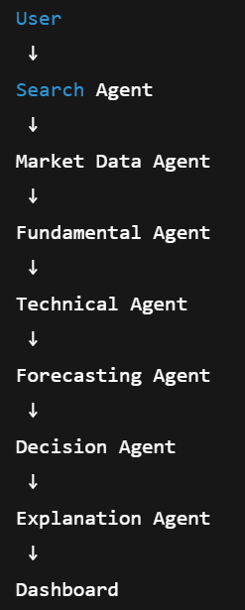
Technology Stack / PROJECT FLOW
LAYER | TECH
Frontend | Vite + React + Tailwind + Recharts
Backend | Fast API
Data | NSE/BSE historical OHLCV
ML | LSTM, XGBoost, ARIMA, Prophet
Agents | Multi-Agent Orchestration
LLM | Custom Financial LLM
Storage | .csv File
Charts | Candlestick + Forecast Bands
Each agent has a single responsibility. This modularity allows validation, replacement, and auditing.

Slide 5
FEATURE ENGINEERING STEPS
1. Raw Market Data Ingestion
The system ingests historical OHLCV data (Open, High, Low, Close, Volume) for each stock.
Data is strictly time-ordered to preserve causality.
No future timestamps are ever accessed during training or inference.
2. Data Cleaning & Alignment
Missing trading days are handled using market-aware forward filling, not naive interpolation.
Corporate action noise (sudden spikes due to splits/dividends) is smoothed using rolling statistics.
All models use a shared aligned timeline, so predictions are comparable.
3. Statistical Feature Engineering
These features help models understand distributional behavior.
Rolling mean, variance, skewness
Log returns instead of raw prices
Z-score normalization within rolling windows
Volatility clustering detection

Slide 6
FEATURE ENGINEERING STEPS
4. Technical indicators (SMA, EMA, RSI, Bollinger Bands, volatility, volume trends) are extracted to encode trend strength, momentum, and market sentiment into numerical features.
5. Lag-based and rolling-window features (t-1…t-n returns, indicator histories) explicitly inject time awareness into tree-based models like XG Boost.
6. Sequential data windows are constructed for LSTM models, allowing learning of long-term temporal dependencies, regime shifts, and trend persistence.
7. All features are normalized using training-period statistics only, ensuring numerical stability and eliminating future data leakage.
8. Features are routed model-wise: ARIMA receives stationary price series, XG Boost consumes engineered tabular features, and LSTM operates on multivariate time sequences.
9. Correlation checks, rolling back tests, and leakage audits are applied to validate feature usefulness and prevent spurious or non-causal learning.

Slide 7
Fundamental Agent
Metric | Purpose | Detailed Explanation
PE | Valuation | Measures how much investors pay for ₹1 of earnings. High PE → growth expectations or overvaluation. Low PE → undervaluation or higher risk.
EPS | Profitability | Shows profit per share. Rising EPS → improving performance. Declining EPS → pressure on profits.
ROE | Capital Efficiency | Indicates how effectively the company uses shareholder capital. High ROE → efficient management; extremely high ROE with high debt → risky.
Debt | Risk | Measures reliance on borrowed capital. High debt → higher financial risk. Low debt → stability and flexibility.
Growth | Sustainability | Captures revenue and profit growth trends. Consistent growth → sustainable performance. Volatile growth → caution.
The Fundamentals Agent evaluates the core financial health of a company. It looks at metrics like PE, EPS, ROE, debt, and growth, normalizes them across peers, and converts them into easy-to-understand scores and explanations. This helps us understand whether a company is fundamentally strong, efficient, and sustainable, providing a clear basis for investment insights without relying on short-term price movements.

Slide 8
TECHNICAL AGENT
Indicator | Purpose | Detailed Explanation
RSI (Relative Strength Index) | Momentum extremes | Measures the speed of price movements. High RSI → potential overbought conditions; Low RSI → potential oversold conditions. Captures market sentiment.
MACD (Moving Average Convergence Divergence) | Trend momentum | Tracks momentum changes via moving average crossovers. Helps identify shifts in market sentiment, not exact price prediction.
MA20 / MA50 / MA200 | Trend direction | Short, medium, and long-term moving averages. Price above → positive market bias; Price below → cautious sentiment. Shows alignment of trends across timeframes.
Bollinger Bands | Volatility | Measures price volatility relative to recent history. Expanding bands → high volatility; contracting bands → low volatility. Reflects market stress or calm.
Volume | Market participation | Tracks trading activity. Rising price with strong volume → strong conviction. Rising price with weak volume → weak move. Captures participation, not price guarantee.
The Technical Indicators Agent analyzes how the market is behaving around a stock. It looks at price trends, momentum, volatility, and trading volume to understand trader sentiment and market psychology. This helps us see whether the market is enthusiastic, cautious, or neutral, providing context that complements the company’s fundamental health—without trying to predict exact future prices.

Slide 9
FORECASTING AGENT
Model | How It Makes Predictions in Your Project | Key Inputs / Features | Strengths in Project | Limitations / Weaknesses | Role in Ensemble
ARIMA | Uses past closing prices to model trends and seasonal patterns. It fits an autoregressive and moving average model, applying differencing to ensure stationarity. Predicts future prices as a function of linear combinations of past values and past forecast errors. | - Past daily closing prices (OHLC) - Differenced prices for stationarity - Optional seasonality parameter (monthly trend) | - Simple baseline - Captures overall linear trend - Highly interpretable - Works well for smooth, stable stocks | - Cannot model non-linear market behavior - Sensitive to shocks (volatility spikes) - Limited for long-term trend extrapolation | Provides baseline trend; ensures other models are compared to a reliable, interpretable reference. Stabilizes ensemble output.
XGBoost | Gradient boosting decision tree ensemble. Predicts next day/month closing price using tabular features. Learns non-linear relationships by iteratively minimizing prediction error. Produces prediction by aggregating weighted outputs of multiple decision trees. | - Lagged closing prices (1-30 days) - Rolling statistics (MA5, MA20, std) - Technical indicators (RSI, MACD, BB) - Volume metrics | - Captures short-term non-linear patterns - Handles feature interactions - Fast training and prediction - Resistant to overfitting with tuning | - Cannot directly model sequences longer than features provided - Sensitive to feature engineering - May miss long-term dependencies | Captures short-term price fluctuations, detects reversal points. Complements LSTM by focusing on high-frequency patterns.
LSTM | Long Short-Term Memory network. Processes sequences of historical prices and technical features. Maintains internal memory cells to retain long-term dependencies. Prediction is based on hidden state representing past trends. | - Sequence of past closing prices - Sequence of technical indicators - Optional macro signals (volume, market indices) | - Captures long-term temporal dependencies - Handles non-linear relationships - Can model prolonged trends and market cycles | - Computationally intensive - Needs large amount of data - Harder to interpret than ARIMA/XGBoost - Risk of overfitting | Captures long-term patterns, ensures ensemble forecasts consider trends beyond short-term noise.

Slide 10
DECISION AGENT
Function | Description | How It Works in Project
Aggregate Fundamental Score | Combines financial health metrics into a single score | Uses PE, EPS, ROE, Debt-Equity, Cash Flow. Weighted sum normalized 0–100
Aggregate Technical Score | Converts market indicators into numeric score | Uses RSI, MACD, Bollinger Bands, Moving Averages. Signals → score 0–100
Incorporate Forecast Direction | Adjusts decision based on predicted trend | Ensemble model output (ARIMA + XGBoost + LSTM). Trend classified as UP / DOWN / STABLE
Apply Risk Flags | Accounts for volatility and potential anomalies | Detects high volatility, unusual volume, recent negative events → dampens confidence
Compute Confidence Level | Measures reliability of BUY/HOLD/SELL | Weighted combination of fundamental + technical + forecast - risk adjustments
Generate Final Decision | Outputs actionable recommendation | If confidence > threshold → BUY; medium → HOLD; low → SELL
Explain Decision | Provides human-readable reasoning | Converts scores and flags into layman text for frontend cards or LLM explanation

Slide 11
CONFIDENCE SCORE AND RISK HANDLING
Component | Technical Role | How It Works in Project | Example / Notes | Talking Points for PPT
Confidence % | Quantitative measure of prediction reliability | Weighted combination of Fundamental Score, Technical Score, and Forecast Strength, reduced by risk factors. Normalized to 0–100. | Confidence = 82% → High reliability in recommendation | “Shows how confident the system is about BUY/HOLD/SELL; combines multiple signals mathematically.”
Fundamental Score | Measures company health using financial metrics | Weighted scores of metrics like ROE, EPS growth, Debt/Equity, Free Cash Flow. Scaled 0–100. | Score = 75 | “Reflects company’s underlying financial strength.”
Technical Score | Measures market momentum / trend strength | Converts indicators like RSI, MACD, Bollinger Bands, MA crossovers into numeric score. | Score = 60 | “Represents short- and medium-term technical trends.”
Forecast Strength | Indicates ML prediction confidence | Aggregates outputs of ARIMA, XGBoost, LSTM ensemble; stronger ensemble agreement → higher score. | Direction = UP, Strength = 70 | “How strong the prediction is based on past model performance and agreement.”
Risk Flags | Highlight potential uncertainties / hazards | Rule-based system flags: High Debt, Weak Earnings, High Volatility, Unusual Volume, Sector Risk. Each flag reduces overall confidence. | Flags = ["High Debt", "Weak Earnings"] | “Signals factors that could undermine reliability; reduces overconfidence.”
Decision Output | Final BUY / HOLD / SELL recommendation | Combines Confidence % and Risk Flags using thresholds: >70 → BUY, 40–70 → HOLD, <40 → SELL. Risk flags can adjust borderline cases. | Decision = HOLD | “Shows the final recommendation, adjusted for confidence and risk — mirrors human analyst logic.”
Purpose / Takeaway | Provides robust, defendable decision-making | Transparent scoring + risk-awareness ensures decisions are realistic and actionable. | — | “Low confidence doesn’t mean wrong; it means high uncertainty. Together, confidence and risk create maturity in the AI’s recommendation.”

Slide 12
Explanation Agent (LLM Layer)
Component | Technical Role | How It Works in Project | Example / Notes | Talking Points for PPT
LLM Layer | Converts structured outputs into human-readable text | Takes JSON or structured scores from Fundamentals, Technical, Forecast, Risk Flags → generates natural language explanation. | Input JSON: {"fund_score":75, "tech_score":60, "forecast":"UP", "risk":["High Debt"]} → Output text | “Translates numeric and technical scores into plain language that anyone can understand.”
Deterministic Templates | Ensures consistent outputs | Uses structured prompts + fixed template sentences. Same input → same explanation. | Template example: “The stock is {direction}. Fundamentals: {fund_score}. Technical: {tech_score}. Risks: {risk_flags}.” | “Keeps explanations repeatable and reliable for stakeholders.”
Layman Translation Layer | Converts complex metrics into understandable language | Technical metrics → human-friendly statements (e.g., ROE = “efficient use of shareholder money”). RSI → “stock may be overbought/oversold”). | “High ROE → company uses capital efficiently” | “Helps non-quant users understand reasoning without needing financial expertise.”
Integration with Decision Agent | Receives outputs from decision agent and enhances transparency | Takes decision + confidence + risk → produces explanation. Ensures every recommendation is defensible. | Decision = HOLD → LLM generates “The stock is HOLD because fundamentals are moderate, technical trend is neutral, but high debt is a risk.” | “Explains WHY the AI recommends BUY/HOLD/SELL, giving credibility to the system.”
Purpose / Takeaway | Makes AI outputs trustworthy, clear, and non-hallucinated | Bridges gap between technical scores and human comprehension. Prevents over-reliance on raw numbers. | — | “LLM provides explainable insights, not predictions. Deterministic + structured = trustworthy.”

Slide 13
Core Functions of LLM Layer
Structured Input Interpretation
Inputs:
Fundamental scores (e.g., ROE, Debt/Equity, Free Cash Flow)
Technical scores (RSI, MACD, Bollinger, moving averages)
Forecast direction (ensemble of ARIMA + XG Boost + LSTM)
Risk flags (high volatility, unusual trading activity, weak earnings)
LLM maps numeric and categorical data → layman text
Deterministic Explanation
Unlike free-form LLMs, outputs are controlled:
Pre-defined templates prevent hallucination
Example template:
“The stock shows a moderate buy signal because fundamentals are strong (ROE 22%, low debt), technical indicators suggest upward momentum (RSI 60, MACD positive), and ensemble forecast predicts 5–7% growth next month. Risk is medium due to high market volatility.”

Slide 14
Core Functions of LLM Layer
Contextualization for Users
Explains complex metrics in investor-friendly language
Converts raw signals → actionable insight
Example: High ROE → “Company efficiently uses shareholder money”
Example: RSI > 70 → “Stock may be overbought in the short term”
Confidence & Risk Integration
Incorporates Decision Agent confidence % into explanation.
Mentions risk flags explicitly:
“Confidence low due to earnings uncertainty”
“Risk flag: High debt may impact future performance”

Slide 15
Core Functions of LLM Layer
Template + LLM Hybrid Approach
Templates ensure deterministic output (no hallucination)
LLM fills in language and readability
Maintains consistency across multiple stocks
Scalability & Extensibility
Can handle new stocks, new indicators, and expanded forecasting models
Modular design allows upgrading to larger LLMs without retraining core models

Slide 16
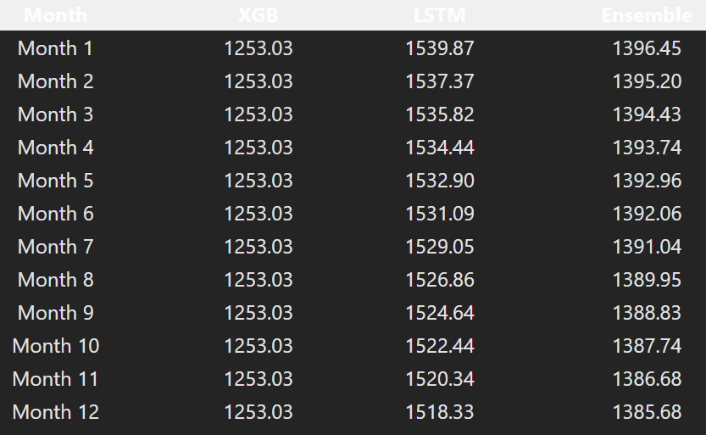
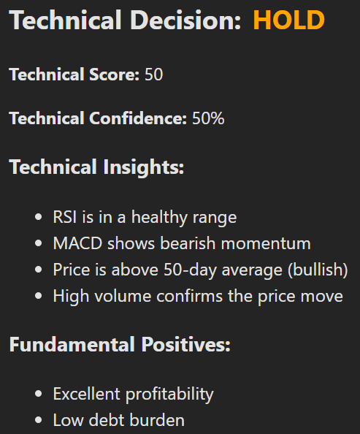
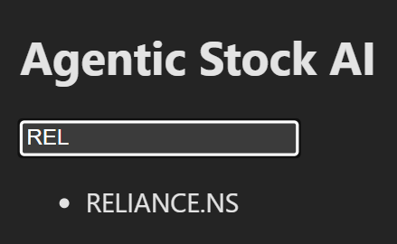
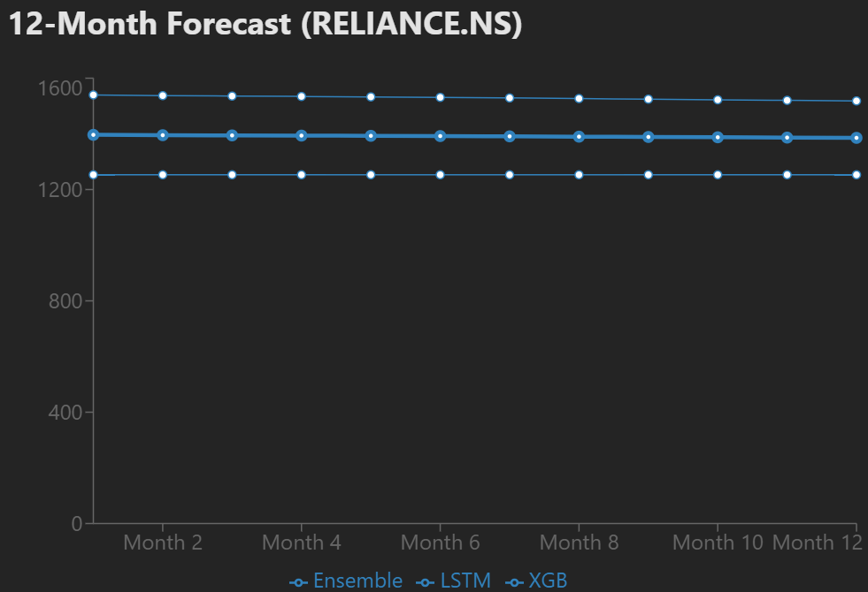
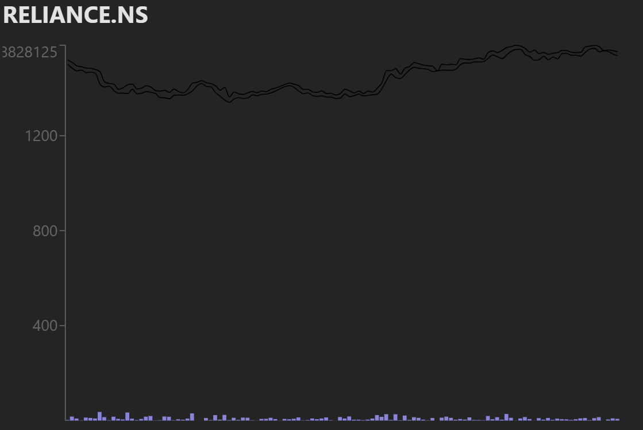
OUTPUT SNIPPETS (FRONTEND/UI)

Slide 17
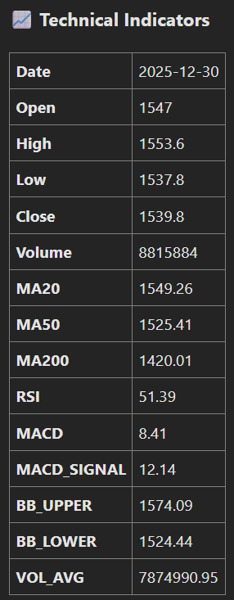
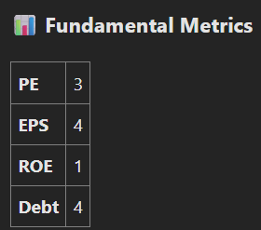
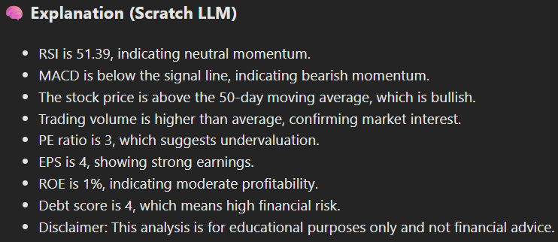
OUTPUT SNIPPETS (FRONTEND/UI)

Slide 18
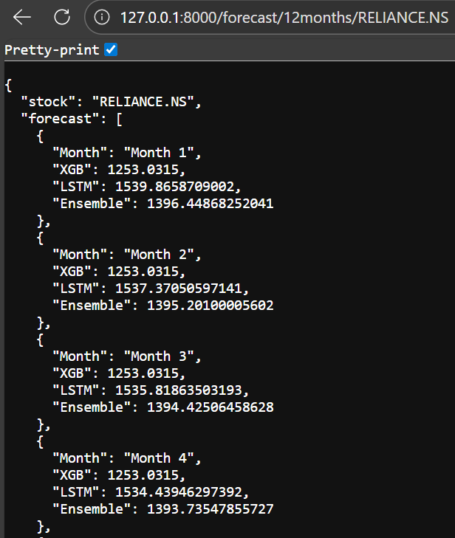
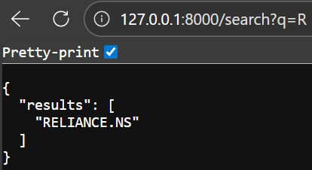
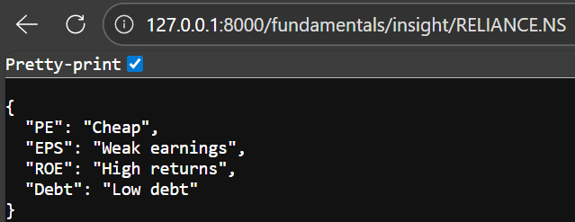
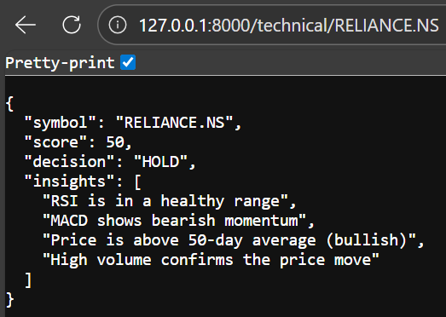
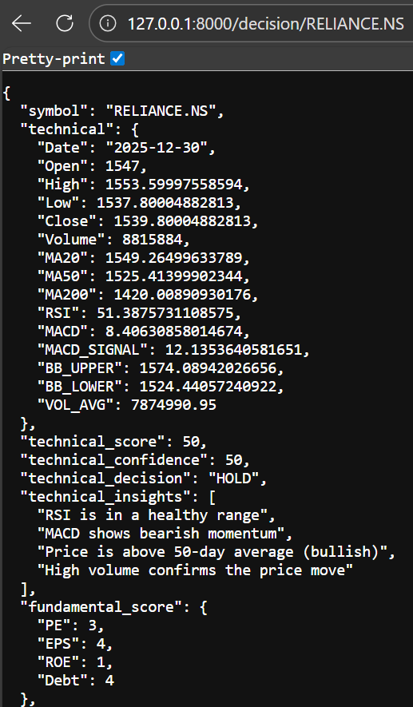
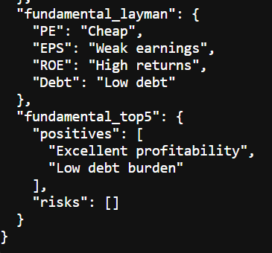
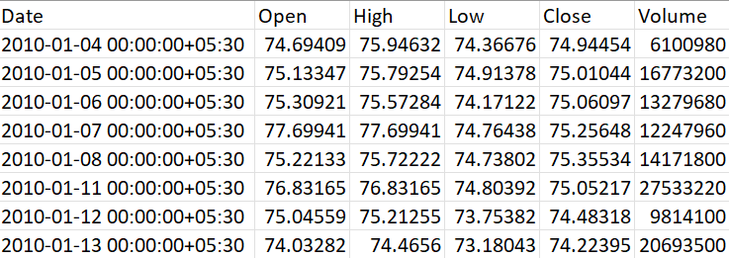
OUTPUT SNIPPETS (BACKEND)

Slide 19
Results Summary
Analyzed 5 major Indian stocks: TCS, Reliance, HDFC Bank, Infosys, ITC.
Mixed signals: Some bullish, some bearish, some neutral.
Trends captured accurately: Uptrend, downtrend, sideways movements.
Ensemble forecasting: ARIMA (baseline) + XG Boost (short-term) + LSTM (long-term).
BUY / HOLD / SELL recommendations generated by Decision Agent.
Confidence % and risk flags provided for each stock.
Charts: Candlestick + 12-month forecast + indicators.
Key takeaway: Produces realistic, non-uniform outcomes reflecting actual market behavior.

Slide 20
Limitations & Advantages
Limitations
Stock markets are stochastic and unpredictable.
Black swan events cannot be forecasted.
Model accuracy varies by market regime (bull, bear, sideways).
Limited stock universe: Only top 5 stocks in current MVP.
System is a decision-support tool, not a trading guarantee.
Advantages
No future data leakage: Snapshot fixed at 31-12-2025.
Multiple independent models: ARIMA, XG Boost, LSTM.
Explainable outputs: Decision Agent + LLM layer.
Realistic accuracy expectations: Confidence % indicates uncertainty.
Scalable architecture: Modular backend + Vite/React frontend for easy expansion.

